Slide 1
Inheriting Bean
http://www.programmingshifts.com/

Slide 2
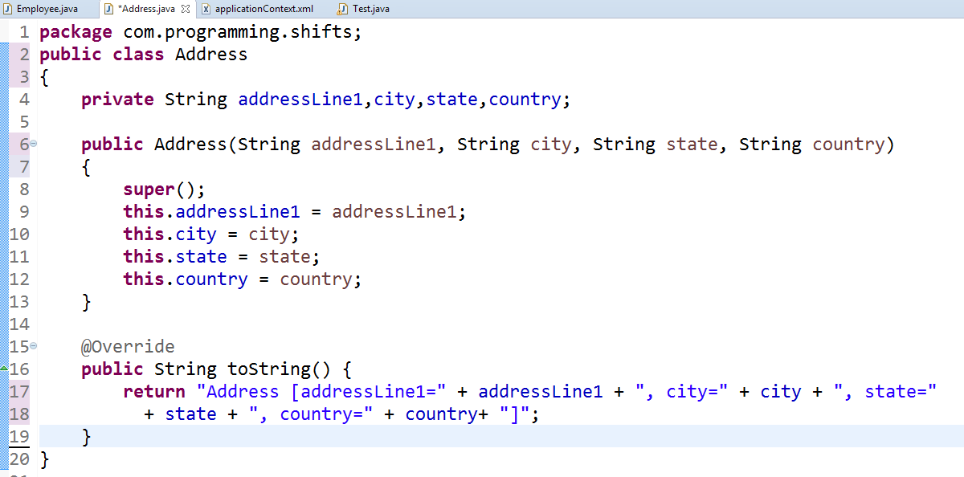

Slide 3
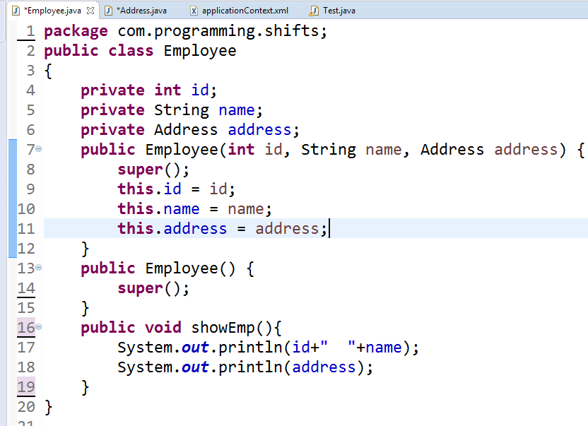

Slide 4
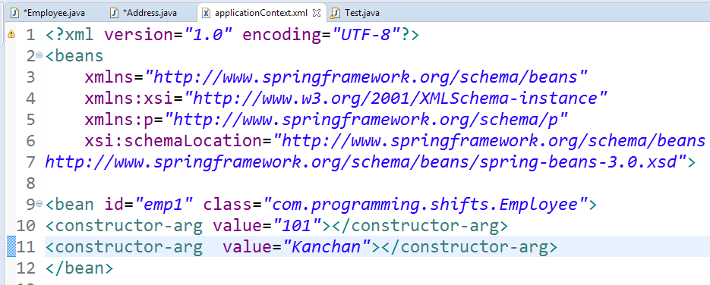


Slide 5
